Slide 1
DSB101 Final Project Theatre
Client

Slide 2
Project Goals
Create a Database for Theatre Events info
Create a Front End interface
Have users View and search for Events
Have users add tickets to Events to a Basket
Checkout and Purchase Tickets
Data Analysis report to help improve theatre traffic

Slide 3
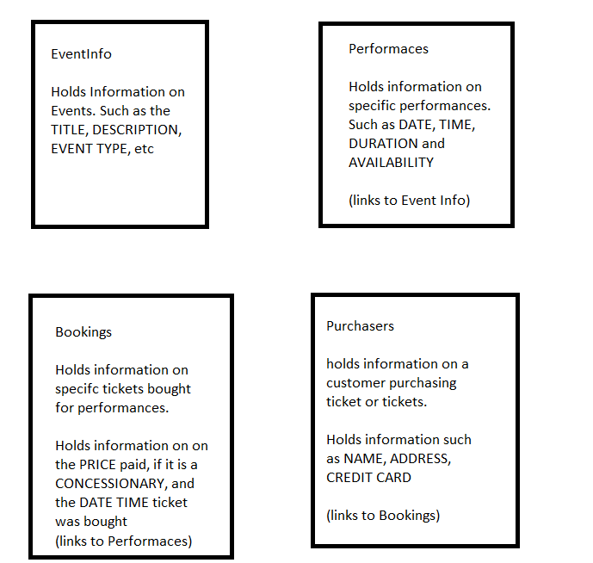
DataBase overview

Slide 4
JAVA overview
Customer can Browse or search for an Event
Then Select an Event from a list for More info
Title, Description, Event type, Language etc
As well as a list of performances of the Event

Slide 5
JAVA overview
A choice to search again OR
Select a performace to buy tickets
Add tickets to basket
View the basket
Checkout,
OR search for more Events

Slide 6
Java Overview
A booking is made
A reference number is given
With which an itemisation of the booking can be shown

Slide 7
Data Analytics
Database logs information
Procedures in place to analyse data
Help identify popular Events
Or types of Events
To maximise traffic and aid in market research

Slide 8
Questions?

Slide 9
DSB101 Final Project Theatre
Managers

Slide 10
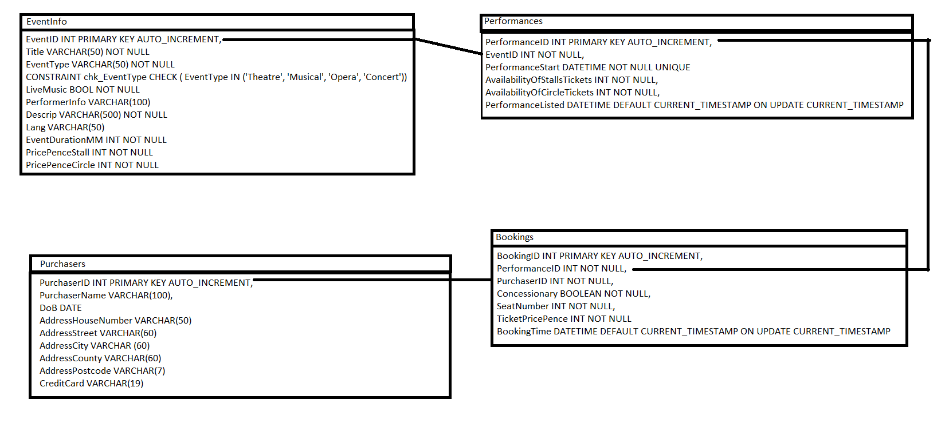
Database ERD

Slide 11
Database Java Connection
MySQL using Called Procedures
All interactions to JAVA
Help Protect agains SQL injection
Flexibility and control returned data
Further commenting to help identify purpose

Slide 12
DataBase Testing
Test_PopulateTables
Add dummy data to tables/test table layout
Test_Procedures
Test Procedures work on SQL side
Test first on SQL side to iron out bugs
If issue occurs can help focus on location of issue

Slide 13
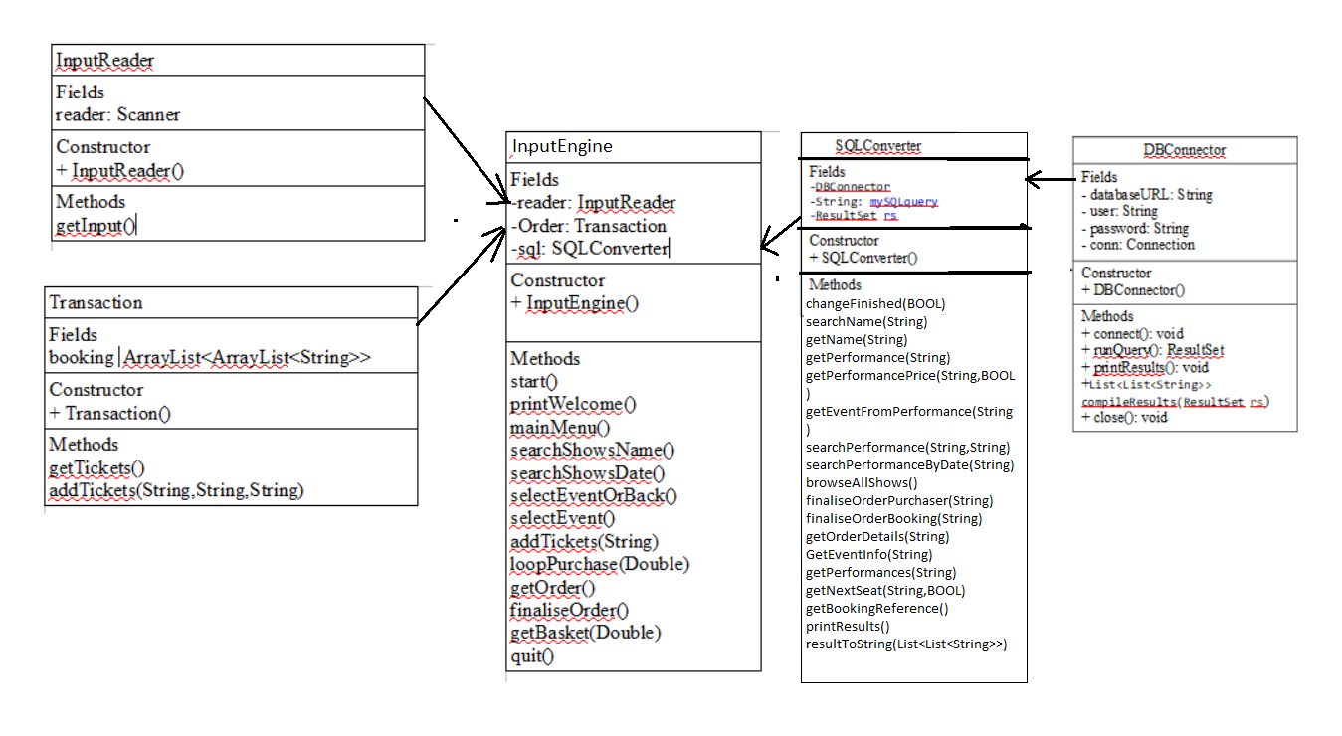
JAVA Class Diagram

Slide 14
Java
Meaningful comments
Testing After changes made
Making use of debug and Step features

Slide 15
DSB101 Final Project Theatre
Using comments to indicate purpose
And to remind of why choices were made
Using Slack, trello, GitHub for collaboration
Version control

